Slide 1
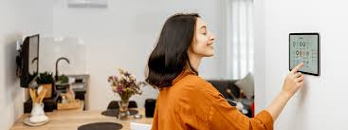
Smart home project

Slide 2
Agenda
Introduction
Objectives
Features
Implementation
Benefits

Slide 3
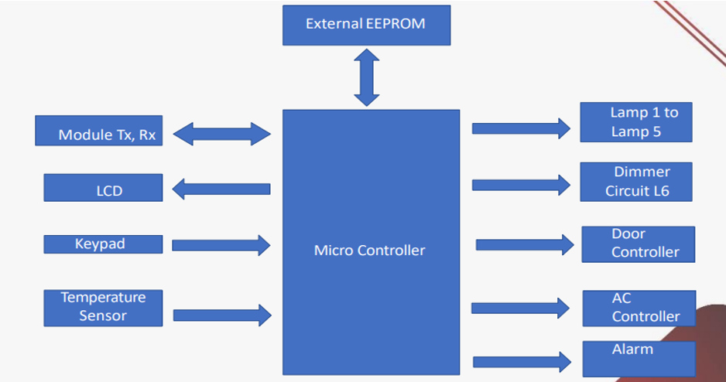
System analysis

Slide 4
features
Door lock
Air conditioner
Lamps
Alarm

Slide 5
Implementation
In our system
we have two modes :
Admin mode : can register any user or remove .
User mode : use LCD and Keypad and can access to all applies except the door opening.
Remoted controlled by mobile or lab top
For emergency cases or controlling without mobile or lap-top use LCD and Keypad “user mode only”.
If admin or any user or passwords are entered wrong more than 3 trial, the system must break down and fire alarm until reset.

Slide 6
Component: LCD&KEYPAD They are used to login to system as a user only. After login, user can control all features except opening door. They can control the system even if any user login by remoted mode except admin until allowing of admin. The interfacing of LCD must display the running devices if the keypad-LCD system is not used. The user’s usernames in this system different than the user’s usernames in the remoting system.

Slide 7
EEPROM Storing the new user to the system “registration”. It must be Read/write in admin mode. It must be read only in user mode. TTL/Bluetooth Transmitting/Receiving between MC and PC/mobile. Every action, Message must be printed on Mobile/PC screen, like: Hey, please Enter your username: . Transmitting/Receiving the commands to run the system.

Slide 8
Temperature Sensor, DC motor Temperature sensor reads the ambient temperature, if the temperature is higher than 28 °C, Air condition must be run “DC motor”, if the temperature becomes lower than 21 °C, Air condition must be turned off “DC motor”. Door The actuator used is a servo motor to control the opening door only in admin mode, it is controlled by command which is send by Mobile/PC “Open\Close the door”.

Slide 9
The end….

